Slide 1
Dr. Sunirmal Khatua
Communication Protocol Stack
Presented By
Visvesvaraya Young Faculty Fellow, Govt. of India
Assistant Professor, University of Calcutta
Notes:
We celebrate Christmas to remember the birth of Jesus Christ

Slide 2
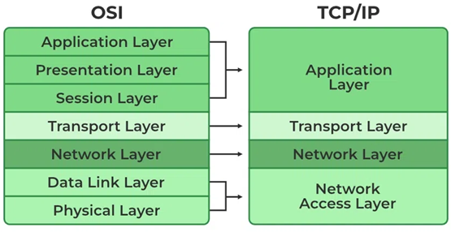
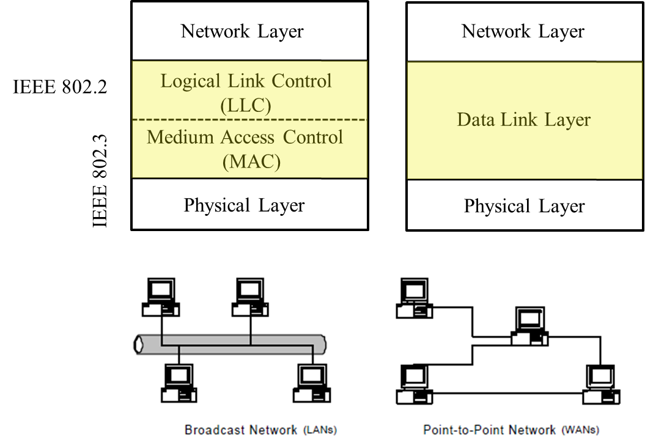
Protocol Stack

Slide 3
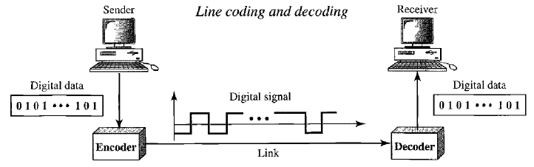
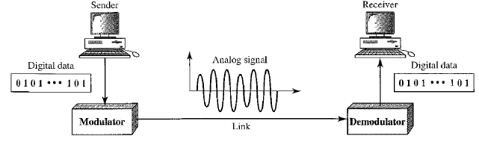
Protocol Stack
Baseband Communication using Line Encoding:
NRZ, Manchester and Differential Manchester
Broadband Communication using Modulation:
ASK, FSK, PSK and QAM

Slide 4





Baseband Communication : Encoding Techniques
Line Encoding is the process of converting digital data to digital signals
0
1
0
1
0
1
1
0
0
1
Baseband Utilization
Self Synchronization
only positive
or
only negative
Synchronization Problem
for both long 0 and long 1
Synchronization Problem
only for long 0
positive
negative
Polarity Inversion Problem
positive, negative & zero

Slide 5
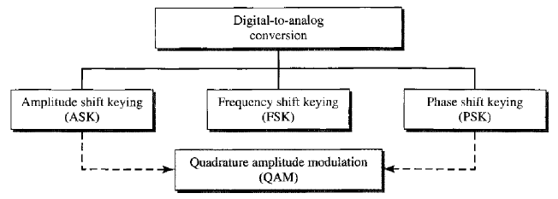
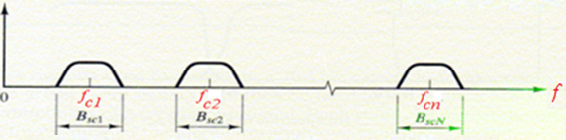



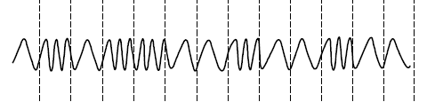

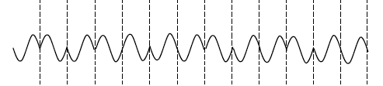
Broadband Communication : Modulation Techniques
Digital Modulation is the process of converting digital data to analog signals
Change Amplitude
Change Frequency
Change Phase

Slide 6
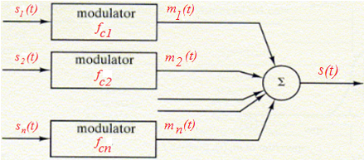
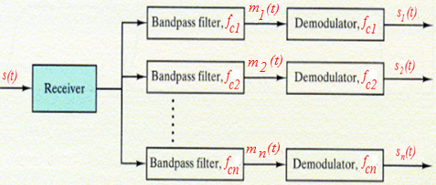
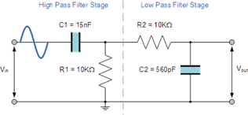


Broadband Communication : Modulation Techniques
Digital Modulation is the process of converting digital data to analog signals

Slide 7
MAC Protocols
Baseband Communication using Line Encoding:
NRZ, Manchester and Differential Manchester
Broadband Communication using Modulation:
ASK, FSK, PSK and QAM

Slide 8
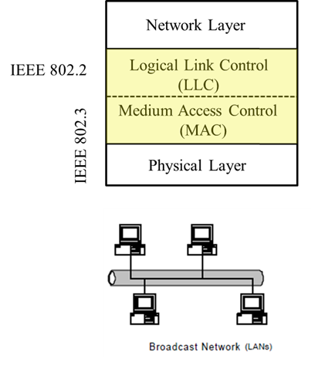
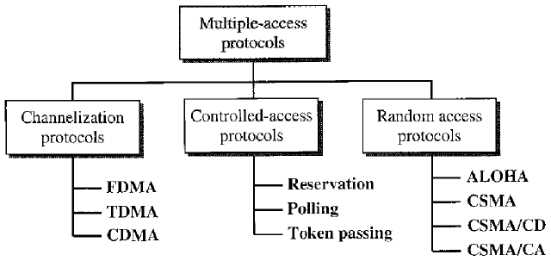
MAC Protocols

Slide 9
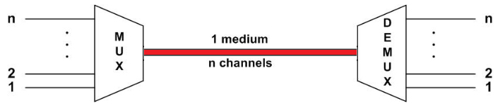
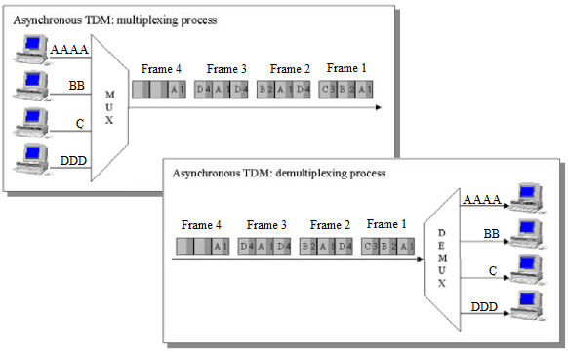
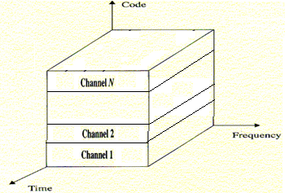
MAC Protocols : Channelization Protocols
A = [ 1 1 1 1 ]
B = [ 1 -1 1 -1 ]
C = [ 1 1 -1 -1 ]
D = [ 1 -1 -1 1 ]
CDMA
Code
Frequency
FDMA
Time
TDMA

Slide 10
MAC Protocols : Channelization Protocols
A = [ 1 1 1 1 ]
B = [ 1 -1 1 -1 ]
C = [ 1 1 -1 -1 ]
D = [ 1 -1 -1 1 ]
Orthogonal Code :
A.B = ∑A_{i}.B_{i} = 0
Sending 0 → Sending Code
Sending 1 → Sending Code
CDMA
Code
Walse Code :
A →(0) C and B→ (1) C
A → [ 1 1 1 1 ]
B → [-1 1 -1 1 ]
C will receive
R → [ 0 2 0 2 ]
At C:
A’s Data = R.A = [ 0 2 0 2 ]. [ 1 1 1 1 ] = 4 → 0
B’s Data = R.B = [ 0 2 0 2 ]. [ 1 -1 1 -1 ] = -4 → 1
D’s Data = R.D = [ 0 2 0 2 ]. [ 1 -1 -1 1 ] = 0 → No Data
W₂ =
1 1
1 -1
Frequency
FDMA
W_{2n} =
W_{n} W_{n}
W_{n} W_{n}
Time
TDMA

Slide 11
MAC Protocols

Slide 12
Questions?
Thank You

